Slide 1

Department of Electronics Engineering
Talkie Text: Text to Speech
D11 Group No: G11-2
Sr No. | Group Member | Roll No.
1. | Ruchita Dolas | 15
2. | Aditi Mishra | 29
3. | Mehul Nikumbh | 33
4. | Atharva Bhaindarkar | 52
Name of Guide: Dr. T Rajani Mangala
Department of Electronics Engineering, VESIT 2022- 23

Slide 2
Department of Electronics Engineering
Department of Electronics Engineering
Introduction
Nearly 5.3 million people in the world are visually impaired.
Also there are many people who are unable to read but can understand a particular language. It would be very much helpful for such people if an application read out to them.
Text-To-Speech (TTS) is a technology that converts a written text into human understandable voice. [1]
Optical Character Recognition (OCR) is a technology that extracts and repurposes data from scanned documents, camera images and image-only pdfs.
Our project aims towards creating an application using ML that will perform TTS and OCR which will be beneficial to the aforementioned community.
Department of Electronics Engineering, VESIT 2022- 23

Slide 3
Department of Electronics Engineering
Department of Electronics Engineering
Literature Review
The papers we reviewed for our project are as follows:
Netra: Smart Hand Gloves Comprises Obstacle Detection, Object Identification & OCR Text to Speech Converter for Blind
Visually Impaired person have to face lot of problems in their day to day life. They suffer from the problem of reading any text and they could not identify any object around them. One of the many applications of the glove is to extract text from any image which contains text and convert it into speech, so the blinds can easily hear the text which they can not see. [3]
An OCR-Enabled Digital Comic Books Viewer
The generalisation of user-friendly and mobile interfaces like smart phones, eBook readers and tablets has accelerated the transition of comic books to the digital format. The underlying platform offers a large number of innovative services which opens a wide spectrum of new possibilities for enhancing accessibility. [4]
Department of Electronics Engineering, VESIT 2022- 23

Slide 4
Department of Electronics Engineering
OCR Text Detector and Audio Convertor Here, many complex text detection systems, like FAST and East algorithms, are used to infer text from a picture. During this article, a mixture of easy filters and detection systems are used. Tesseract is implementing an extended Short-Term Memory (LSTM) based recognition engine which may be a quite Recurrent Neural Network (RNN). OCR text output is converted into an audio output using gTTS, a screen reader application developed to convert text into speech for our OCR system. This approach leads to uncomplicated and accurate text detection from document images and converts them into speech. [2]
OCR Oriented Reading System for Blind People During this system, the application will scan and convert the content that is written in English (West Germanic language) accent into a speech format. By victimization of the Text to Speech Module speech output is generated. The seek of coming up with the type of voice/speech is to give out datum that is bestowed in the given image to the visually impaired people. [5]
Department of Electronics Engineering, VESIT 2022- 23

Slide 5
Department of Electronics Engineering
Software Scheme
Software | Specification
Python | (3.10.1)
IDE | (Google Colab)
IDE | (VS Code)
Flask | (version 2.2.3)
Department of Electronics Engineering, VESIT 2022- 23

Slide 6
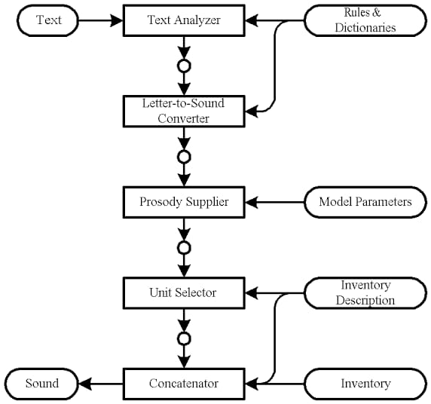
Department of Electronics Engineering
Block Diagram
Block Diagram of a Text-to-Speech System with Concatenative Synthesis [1]
Department of Electronics Engineering, VESIT 2022- 23

Slide 7
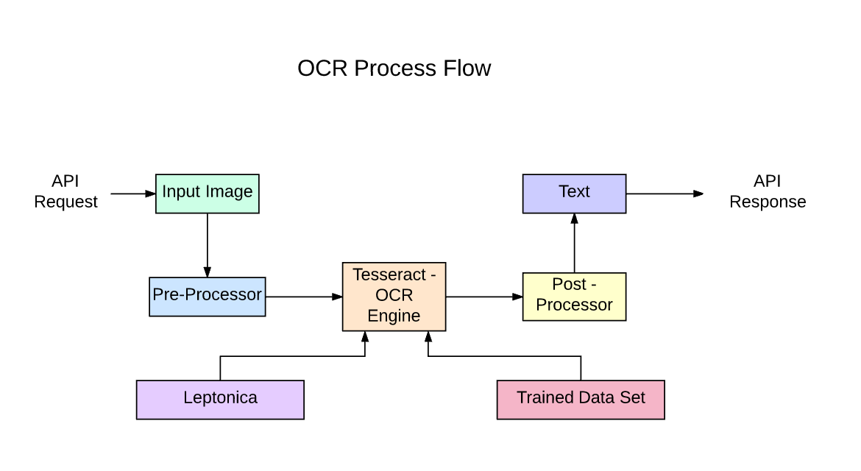
Department of Electronics Engineering
Block Diagram
Flowchart of OCR Tesseract [2]
Department of Electronics Engineering, VESIT 2022- 23

Slide 8
Department of Electronics Engineering
Pre Processing
Binarization: Binarisation means converting a coloured image into an image which consists of only black and white pixels (Black pixel value=0 and White pixel value=255).
Skew Correction: While scanning a document, it might be slightly skewed (image aligned at a certain angle with horizontal) sometimes. While extracting the information from the scanned image, detecting & correcting the skew is crucial.
Noise Removal: It smoothens the image by removing small dots/patches which have high intensity than the rest of the image. Noise removal can be performed for both Coloured and Binary images.
Department of Electronics Engineering, VESIT 2022- 23

Slide 9
Department of Electronics Engineering
Data Processing
Feature Detection: Feature Detection involves taking the cluster of pixels and identifying features such as basic shapes that make up a letter.
Feature Extraction: The feature extraction stage is used to extract the most relevant information from the text image which helps us to recognize the characters in the text.
Classification and Pattern Recognition: This is the part of the process that classifies a cluster representing an unknown character into a specific character.
Department of Electronics Engineering, VESIT 2022- 23

Slide 10
Department of Electronics Engineering
Post Processing
OCR Post Processing involves correcting errors that were generated during the OCR process.
In the case that the OCRed text is a continuous thought written in a language that a reader understands, it is likely they could correct almost all errors.
If the text was encrypted or has no context or meaning. Then correcting these errors is nearly impossible without the original images.
Department of Electronics Engineering, VESIT 2022- 23

Slide 11
Department of Electronics Engineering
CER
It stands for character error rate
Levenshtein distance is a distance metric measuring the difference between two string sequences.
It is the minimum number of single-character (or word) required to change one word (or sentence) into another.
It is represented with this formula:
CER=(S+D+I)/N
S = Number of Substitutions
D = Number of Deletions
I = Number of Insertions
N = Number of characters in reference text
Department of Electronics Engineering, VESIT 2022- 23

Slide 12
Department of Electronics Engineering
WER
It stands for Word Error Rate
WER is basically the number of errors divided by the total words.
Word Error Rate Formula:
WER = (S + I + D) / N
S=Substitutions
I=Insertions
D=Deletions
N= Number of Words
Department of Electronics Engineering, VESIT 2022- 23

Slide 13
Department of Electronics Engineering
References
[1] Markus Schnell, Michael Küstner, “Text-to-Speech for Low-Resource Systems”, in IEEE, 2002.
[2] Himank Dave, Aryaman Gobse, Aryika Goel, Swati Bairagi, “OCR Text Detector and Audio Convertor”, in IJRASET, 2020.
[3] N.K. Srivastava, Satyam Singh, “Netra: Smart Hand Gloves Comprises Obstacle Detection, Object Identification & OCR Text to Speech Converter for Blinds”, in IEEE, 2018.
[4] Christophe Ponsard, Ravi Ramdoyal, Daniel Dziamski, “An OCR-Enabled Digital Comic Books Viewer”, in ICCHP, 2012.
[5] Pooja Shree H R, Dr. Revathi, “OCR Oriented Reading System for Blind People”, in AjCt, in 2022
Department of Electronics Engineering, VESIT 2022- 23

Slide 14
Department of Electronics Engineering
[5] https://www.ncbi.nlm.nih.gov/pmc/articles/PMC5820628/
[6] https://towardsdatascience.com/pre-processing-in-ocr-fc231c6035a7
Department of Electronics Engineering, VESIT 2022- 23

Slide 15
Department of Electronics Engineering
Thank You!!
Department of Electronics Engineering, VESIT 2022- 23

